Slide 1

Artificial Intelligence
Chris Piech
CSBridge 2020

Slide 2
A Little AI

Slide 3
Something big is happening
in the world of AI…
Notes:
hoy tenemos una mañana muy emocionante

Slide 4
Where is my robot?

Slide 5
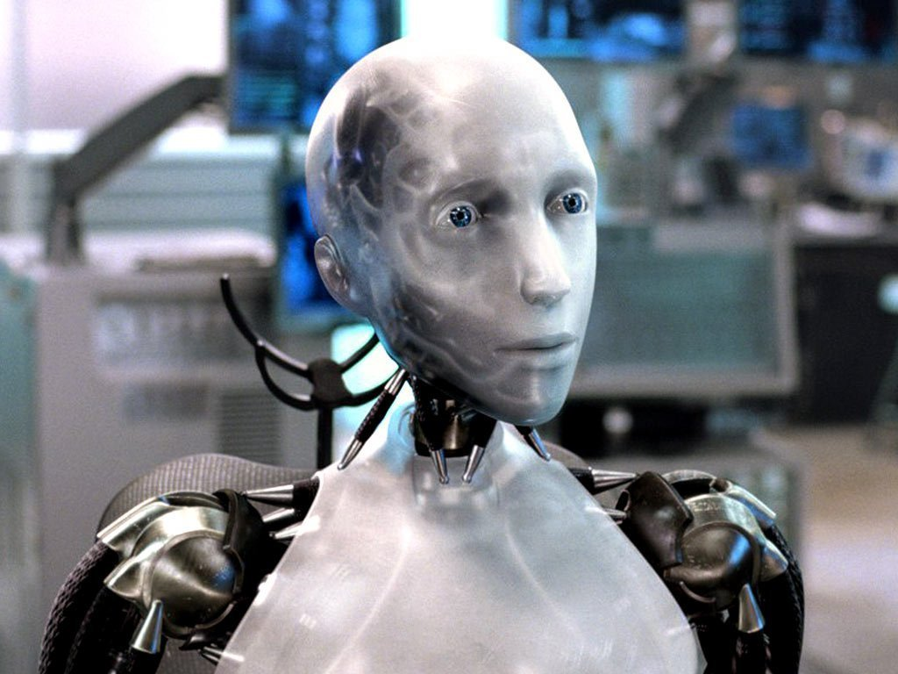
Sci-Fi Has Promised Me Robots

Slide 6
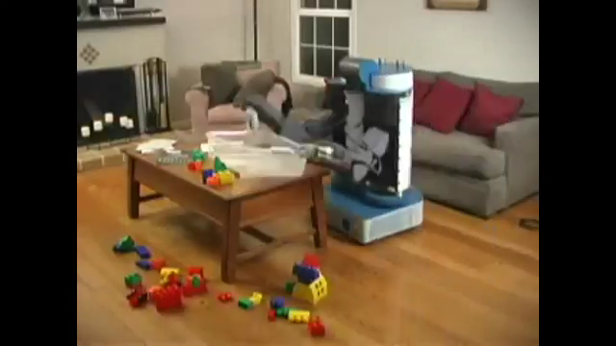
House Cleaning Robot

Slide 7
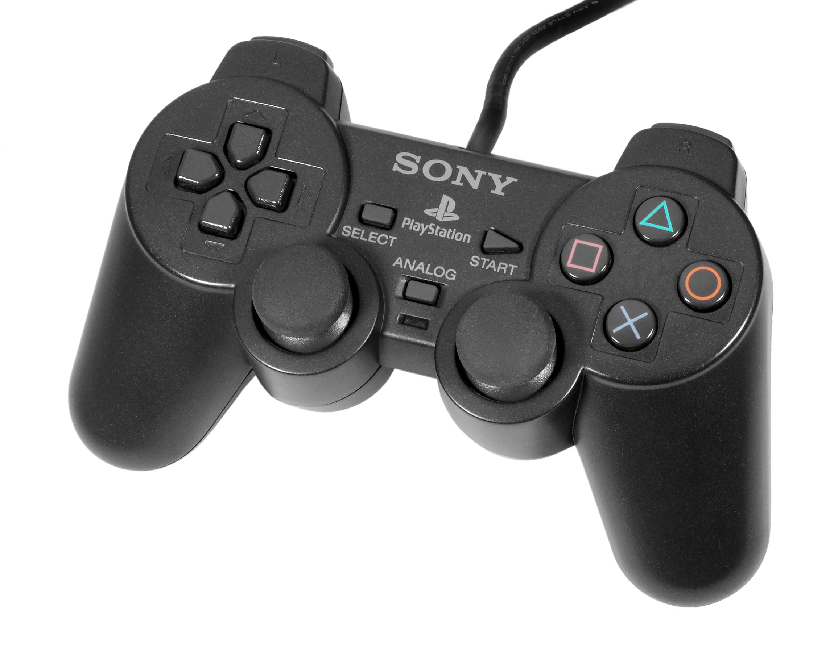
House Cleaning Robot

Slide 8
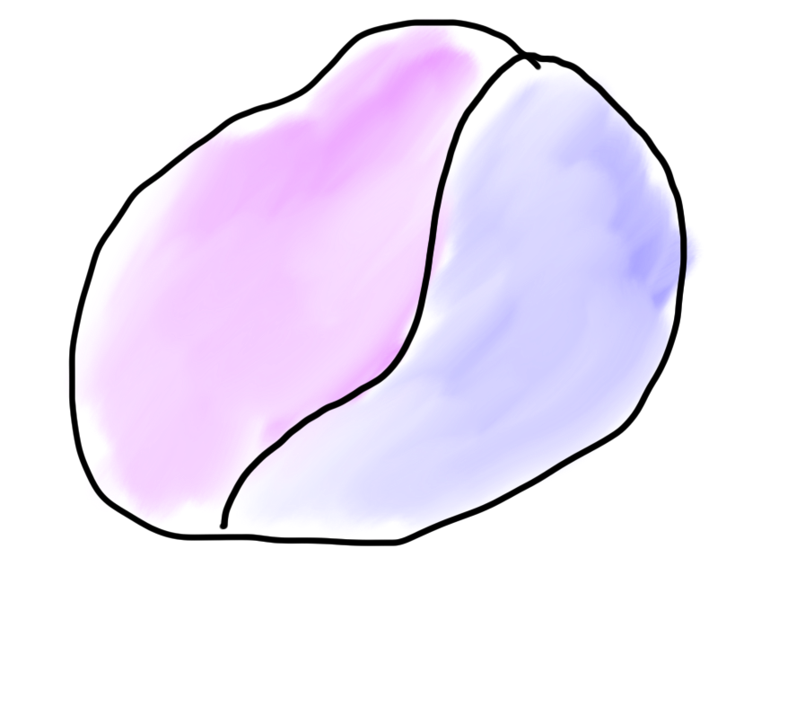
Robots?
Mind
Body

Slide 9

Robots?
Mind
Body

Slide 10
What is AI?

Slide 11
[suspense]

Slide 12
AI: The study and design of intelligent agents

Slide 13
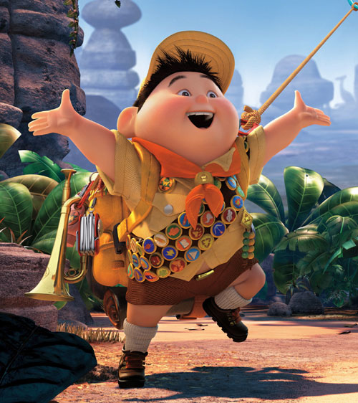
Volunteer

Slide 14
Computer
programs
AI: The study and design of intelligent agents
Better than
chance
As well as
humans

Slide 15
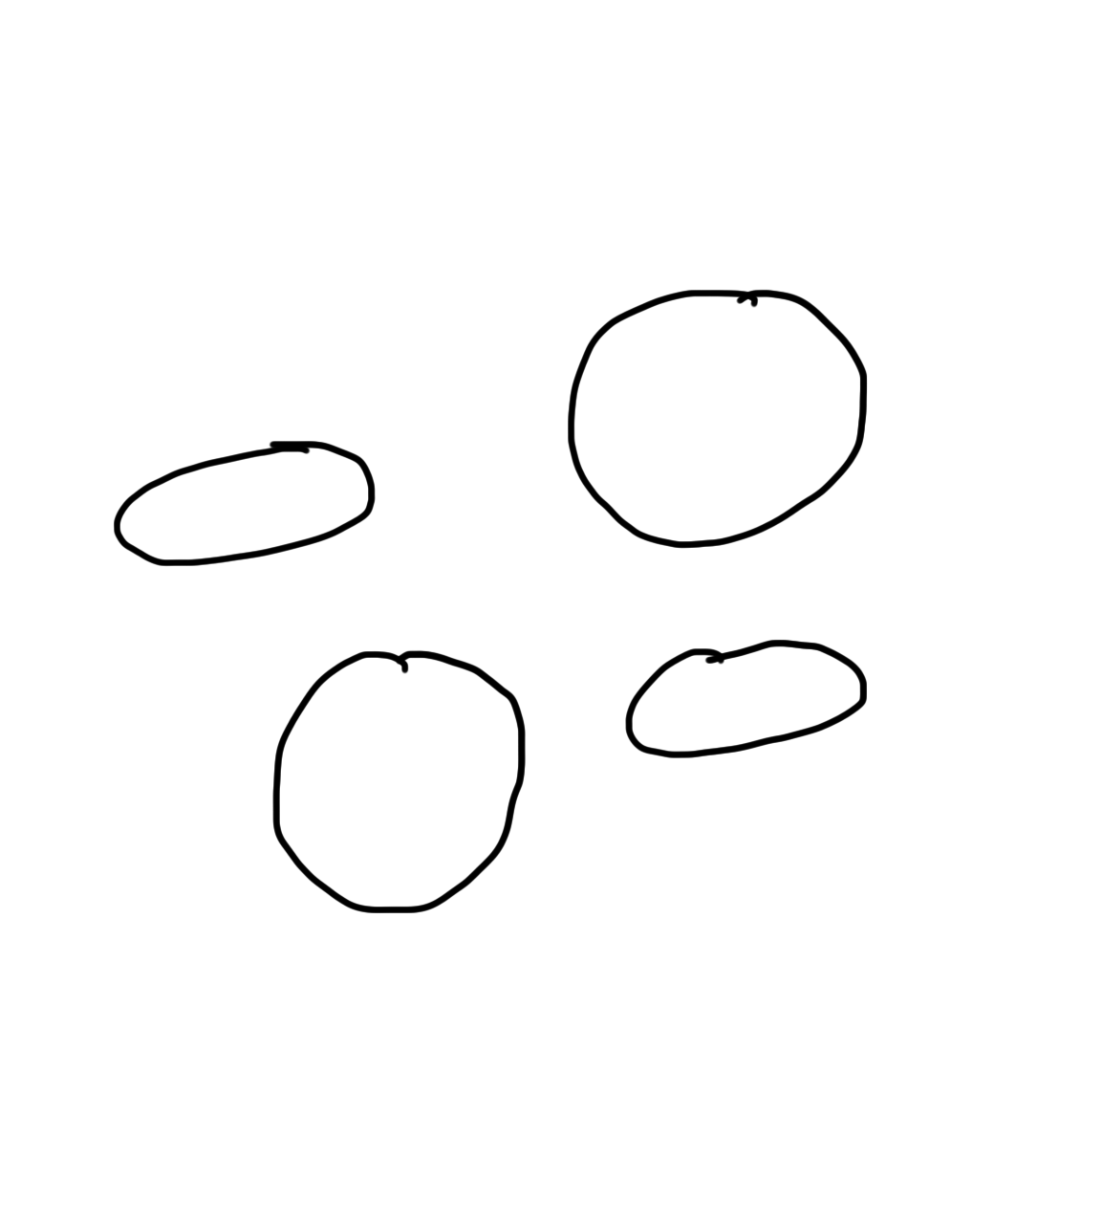
Narrow Intelligence
Translate
Turkish or Czech
Play Chess
Play Breakout
Drive a
Car

Slide 16
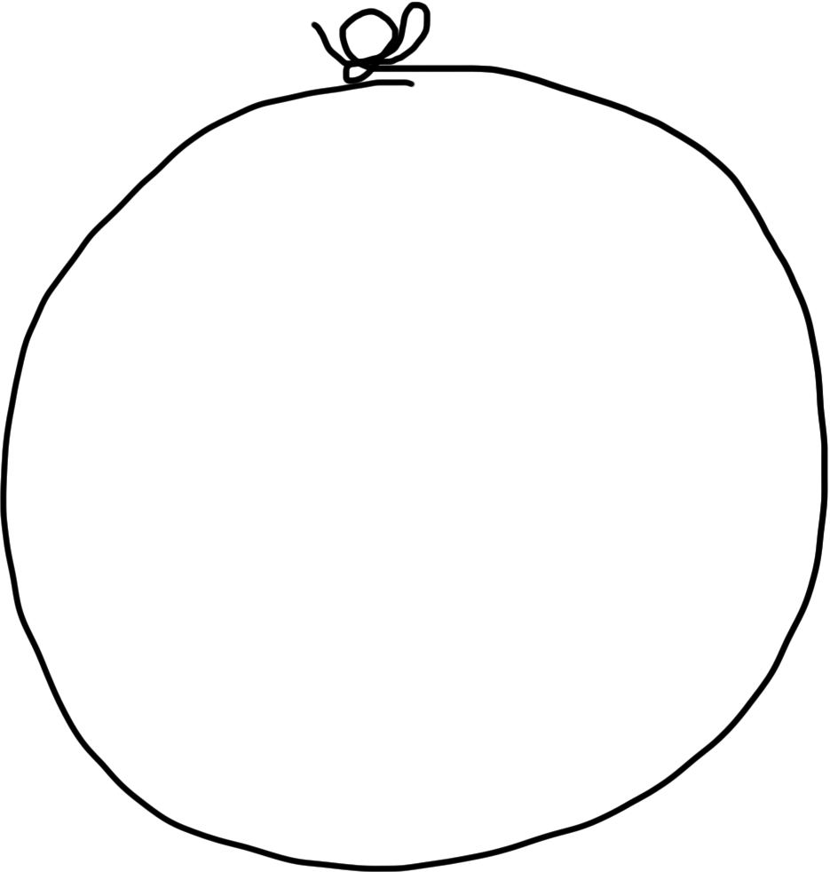
General Intelligence
Translate
Turkish
Play Chess
Play Breakout
Drive a
Car

Slide 17
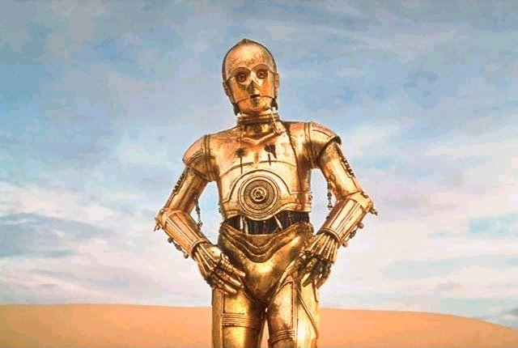
Brief History

Slide 18
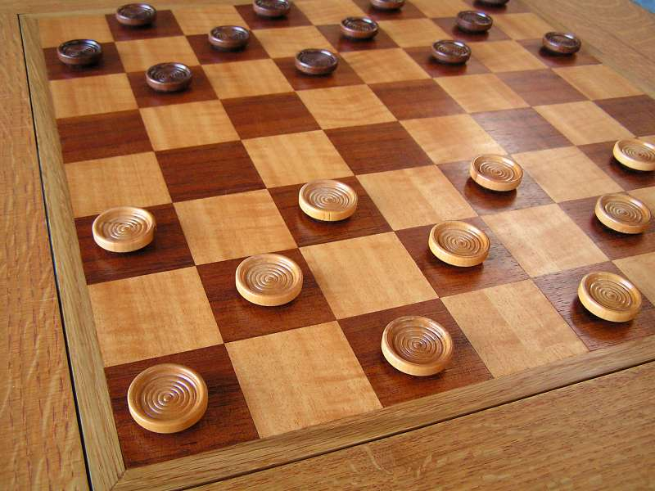
Early Optimism 1950s
1952

Slide 19
Early Optimism 1950s
“Machines will be capable, within twenty years, of doing any work a man can do.”
–Herbert Simon, 1952

Slide 20
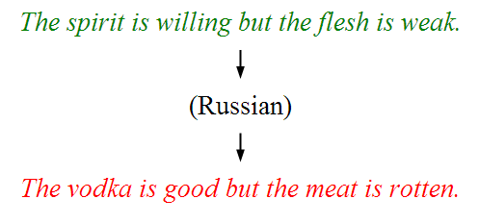
Underwhelming Results 1950s to 1980s
The world is too complex

Slide 21


Slide 22

Big Milestones

Slide 23

Told Speech Was 30 Years Out
Almost perfect…

Slide 24
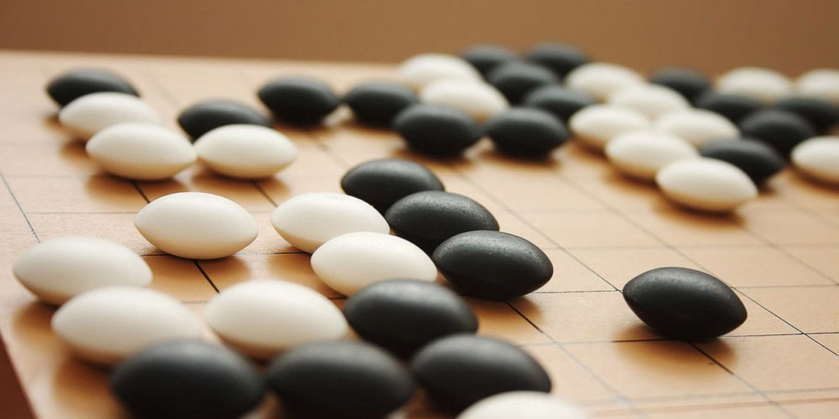
The Last Remaining Board Game

Slide 25
Computers Making Art

Slide 26
Self Driving Cars

Slide 27
What is going on?

Slide 28
[more suspense]

Slide 29
Story of Modern AI

Slide 30
Focus on one problem

Slide 31
Make a Harry Potter Sorting Hat

Slide 32

Classification
Logistic Regression is like the Harry Pottery Sorting Hat
That is a picture
of a one

Slide 33

Classification
Logistic Regression is like the Harry Pottery Sorting Hat
That is a picture
of a zero

Slide 34

Classification
That is a picture
of an zero
* It doesn’t have to be correct all of the time

Slide 35
Can you do it?

Slide 36


Slide 37


Slide 38

How about now?
What a computer sees
0 | 0 | 1 | 0 | 1 | 0 | 1 | 0 | 0 | 0 | 1 | 1 | 1 | 0 | 1
1 | 0 | 0 | 1 | 0 | 1 | 1 | 1 | 0 | 1 | 0 | 0 | 0 | 0 | 0
1 | 1 | 1 | 0 | 1 | 0 | 0 | 1 | 1 | 0 | 0 | 1 | 0 | 1 | 0
1 | 1 | 1 | 1 | 1 | 0 | 0 | 0 | 0 | 0 | 1 | 1 | 0 | 1 | 1
0 | 0 | 0 | 1 | 1 | 0 | 0 | 1 | 0 | 0 | 0 | 1 | 1 | 1 | 0
1 | 0 | 0 | 1 | 1 | 0 | 0 | 0 | 1 | 0 | 1 | 1 | 1 | 1 | 0
1 | 1 | 0 | 1 | 1 | 0 | 0 | 1 | 1 | 0 | 1 | 1 | 1 | 0 | 0
1 | 0 | 1 | 0 | 0 | 1 | 0 | 0 | 1 | 0 | 0 | 1 | 1 | 1 | 1
0 | 0 | 0 | 0 | 1 | 0 | 1 | 0 | 1 | 1 | 0 | 0 | 1 | 1 | 1
0 | 1 | 1 | 0 | 0 | 0 | 0 | 0 | 1 | 1 | 1 | 1 | 1 | 1 | 0
0 | 0 | 1 | 0 | 1 | 1 | 1 | 0 | 0 | 0 | 1 | 0 | 0 | 0 | 0
0 | 1 | 1 | 1 | 0 | 1 | 0 | 0 | 1 | 0 | 0 | 0 | 0 | 0 | 1
1 | 1 | 0 | 0 | 0 | 0 | 0 | 0 | 0 | 0 | 1 | 0 | 0 | 1 | 1
0 | 0 | 0 | 0 | 0 | 0 | 0 | 0 | 1 | 1 | 1 | 1 | 0 | 0 | 1
0 | 0 | 1 | 1 | 1 | 0 | 1 | 0 | 1 | 1 | 0 | 0 | 0 | 1 | 0
What a human sees

Slide 39
Why is it easy for Humans?
About 30% of your cortex is used for vision
3% is used to process hearing

Slide 40
Very hard to Program
??
def main():
print(“Todo: Write program”)

Slide 41
Perhaps there is an insight?

Slide 42
Two Great Ideas
1. Artificial Neurons
2. Learn by Example

Slide 43
Two Great Ideas
1. Artificial Neurons
2. Learn by Example

Slide 44
1. Artificial Neurons

Slide 45
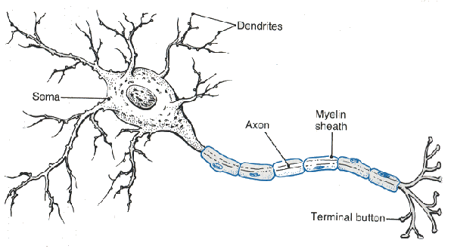
Neuron

Slide 46
Neuron

Slide 47
Neuron

Slide 48
Neuron

Slide 49
Neuron

Slide 50
Some Inputs are More Important

Slide 51
Artificial Neuron

Slide 52




Inputs
+

Slide 53
Inputs
+

Slide 54
Inputs
+

Slide 55
Weights
+

Slide 56
Weights
+

Slide 57
Weights
+

Slide 58
Weighted Sum
+
weightedSum = 0
weightedSum = weightedSum + input0 * weight0
weightedSum = weightedSum + input1 * weight1
weightedSum = weightedSum + input2 * weight2
weightedSum = weightedSum + input3 * weight3

Slide 59
Weighted Sum
+
weightedSum = 0
for i in range(4):
weightedSum += weight[i] * input[i]

Slide 60
Filter and Output
+

Slide 61
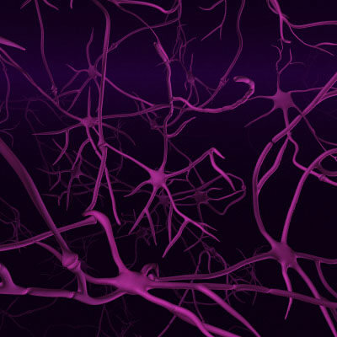
Biological Basis for Neural Networks
A neuron
Your brain
Actually, it’s probably someone else’s brain
???

Slide 62
Put Many Together
+
+
+
+

Slide 63
Put Many Together
+
+
+
+

Slide 64
Put Many Together
Input Neurons
Hidden Neurons
Output Neurons

Slide 65
Making a Prediction
Input Neurons
Hidden Neurons
Output Neurons
…

Slide 66
Making a Prediction
Input Neurons
Hidden Neurons
Output Neurons
…

Slide 67
Making a Prediction
Input Neurons
Hidden Neurons
Output Neurons
…

Slide 68
Making a Prediction
Input Neurons
Hidden Neurons
Output Neurons
I think that is a picture of a one!
…

Slide 69
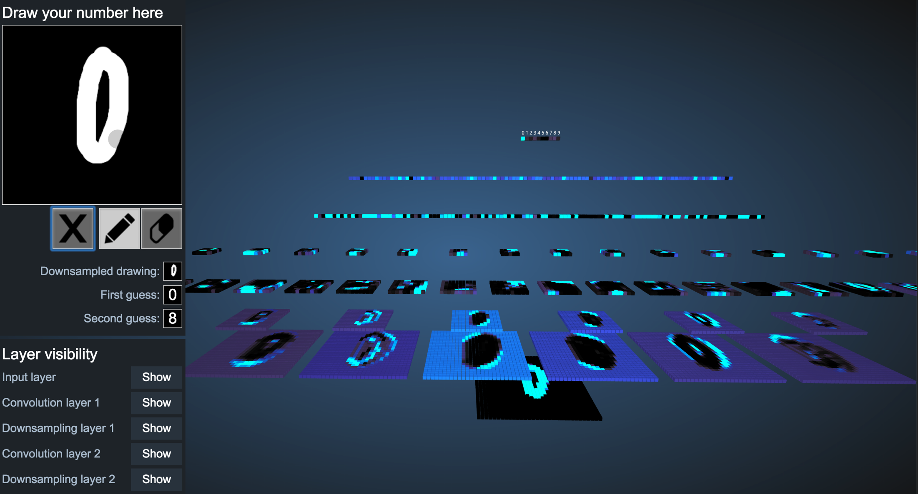
Demonstration
http://scs.ryerson.ca/~aharley/vis/conv/

Slide 70
Great Idea: Artificial Neurons

Slide 71
Neural Networks get their intelligence from their sliders (parameters)

Slide 72
Two Great Ideas
1. Artificial Neurons
2. Learn by Example

Slide 73
Two Great Ideas
1. Artificial Neurons
2. Learn by Example

Slide 74
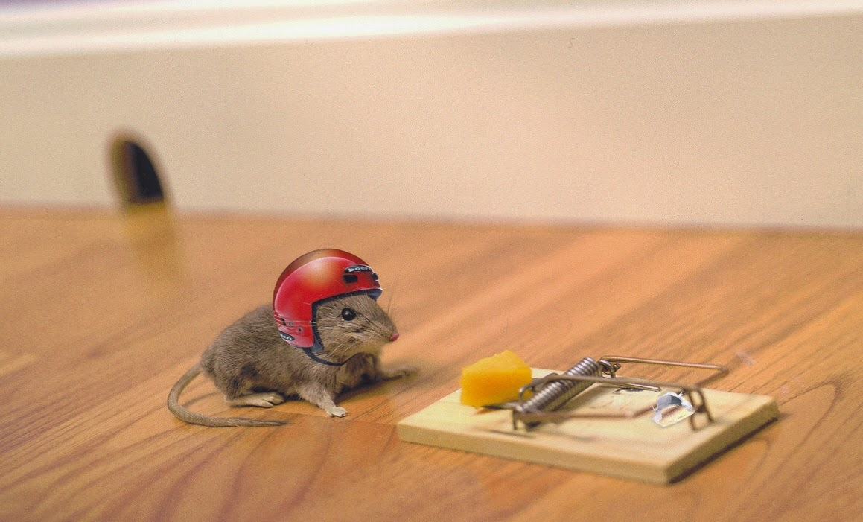
2. Learn From Experience

Slide 75

Learn by Example

Slide 76
+

Slide 77
+

Slide 78
I think that is a picture of a One!
+
What do you mean it’s actually a Zero?
I’ll adjust my sliders so that I do a better job in the future

Slide 79
I think that is a picture of a One!
+
What do you mean it’s actually a Zero?
I’ll adjust my sliders so that I do a better job in the future

Slide 80
+

Slide 81
+

Slide 82
+

Slide 83
I think that is a picture of a One!
+
Wahoo I got it right!

Slide 84
+

Slide 85
+

Slide 86
I think that is a picture of a zero!
+
What do you mean it’s actually a one?
I’ll adjust my sliders so that I do a better job in the future

Slide 87
I think that is a picture of a zero!
+
What do you mean it’s actually a one?
I’ll adjust my sliders so that I do a better job in the future

Slide 88
Study Hard!

Slide 89
Train on Faces

Slide 90
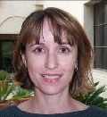
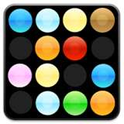
Visualize the Sliders
object models
object parts
(combination
of edges)
Training set: Aligned
images of faces.
edges
pixels
[Honglak Lee]

Slide 91
Woah… that’s like a brain…

Slide 92
True.

Slide 93
Decomposition
Mountain Karel
Climb Up Mountain
Step Up
Pick Beeper
Climb Down Mountain
Step Down
Notes:
He looks like an old machintosh machine.
Hes got legs… one sticks out the back. That’s just the way it is.

Slide 94
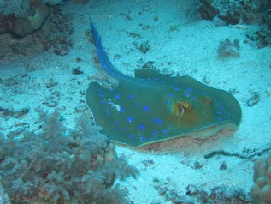
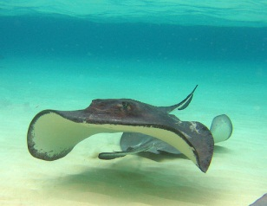
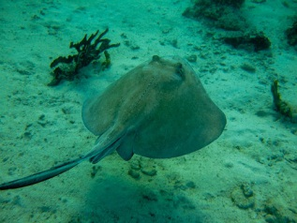
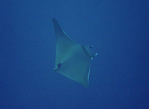
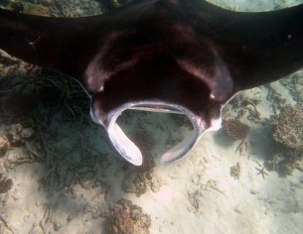
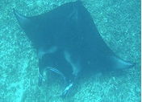
Image Net Classification
…
smoothhound, smoothhound shark, Mustelus mustelus
American smooth dogfish, Mustelus canis
Florida smoothhound, Mustelus norrisi
whitetip shark, reef whitetip shark, Triaenodon obseus
Atlantic spiny dogfish, Squalus acanthias
Pacific spiny dogfish, Squalus suckleyi
hammerhead, hammerhead shark
smooth hammerhead, Sphyrna zygaena
smalleye hammerhead, Sphyrna tudes
shovelhead, bonnethead, bonnet shark, Sphyrna tiburo
angel shark, angelfish, Squatina squatina, monkfish
electric ray, crampfish, numbfish, torpedo
smalltooth sawfish, Pristis pectinatus
guitarfish
roughtail stingray, Dasyatis centroura
butterfly ray
eagle ray
spotted eagle ray, spotted ray, Aetobatus narinari
cownose ray, cow-nosed ray, Rhinoptera bonasus
manta, manta ray, devilfish
Atlantic manta, Manta birostris
devil ray, Mobula hypostoma
grey skate, gray skate, Raja batis
little skate, Raja erinacea
…
Stingray
Mantaray

Slide 95
0.005%
1.5%
?
Random guess
Pre Neural Networks
GoogLeNet
Le, et al., Building high-level features using large-scale unsupervised learning. ICML 2012

Slide 96
0.005%
1.5%
43.9%
Random guess
Pre Neural Networks
GoogLeNet
Szegedy et al, Going Deeper With Convolutions, CVPR 2015

Slide 97
0.005%
1.5%
66.3%
Random guess
Pre Neural Networks
2016
http://image-net.org/challenges/LSVRC/2016/results

Slide 99

Google Brain

Slide 100
Google Brain
1 Trillion Artificial Neurons

Slide 101
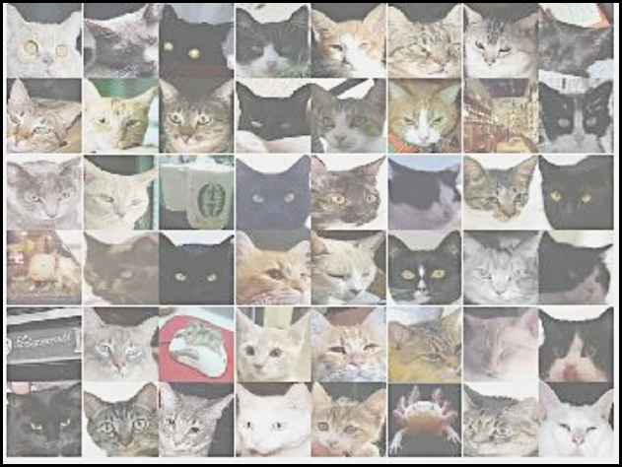
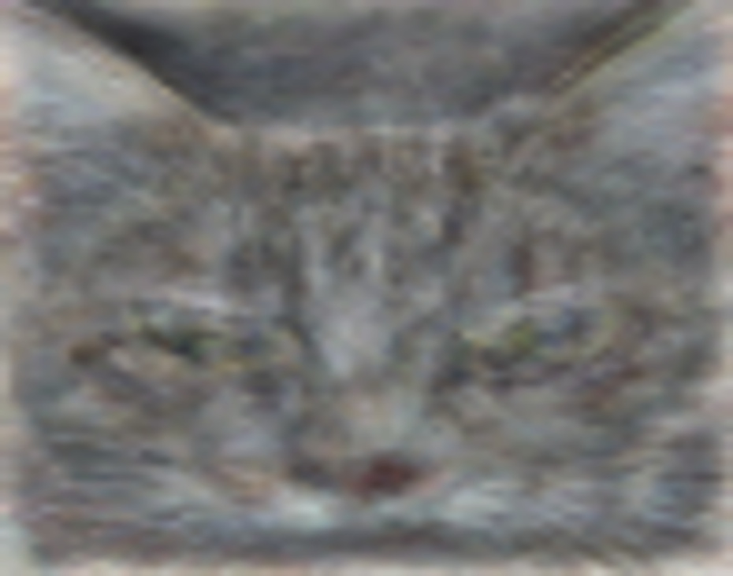
A Neuron That Fires When It Sees Cats
Top stimuli from the test set
Optimal stimulus
by numerical optimization
Le, et al., Building high-level features using large-scale unsupervised learning. ICML 2012

Slide 103



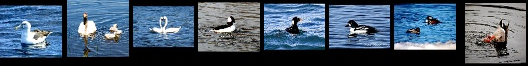

Other Neurons
Neuron 1
Neuron 2
Neuron 3
Neuron 4
Neuron 5
Le, et al., Building high-level features using large-scale unsupervised learning. ICML 2012
Input to another layer above
(image with 8 channels)
Number of output
channels = 8
LCN Size = 5
H
Pooling Size = 5
Number
of maps = 8
One layer
W
RF size = 18
Number of input
channels = 3
Image Size = 200

Slide 104
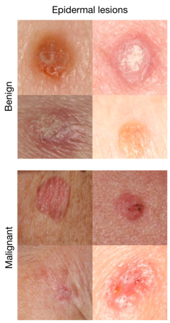
It can be useful
An algorithm learned to detect skin cancer from photo, better than the worlds top expert.
Developed last year
Esteva, Andre, et al. "Dermatologist-level classification of skin cancer with deep neural networks." Nature 542.7639 (2017): 115-118.
Esteva et al., Nature 2017.

Slide 105
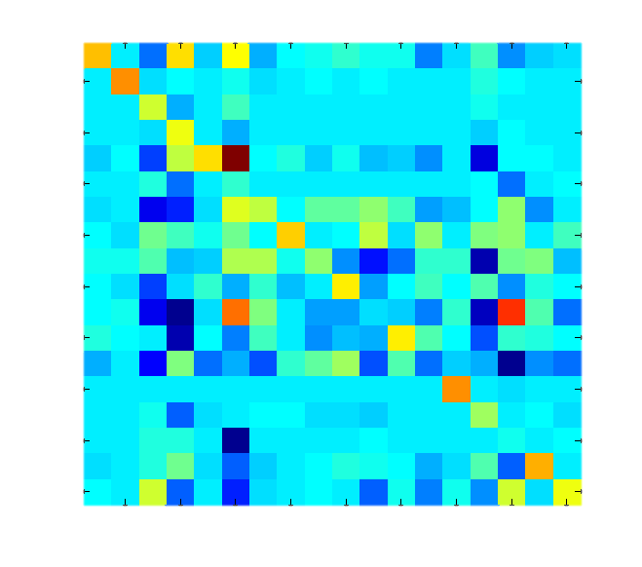
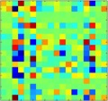
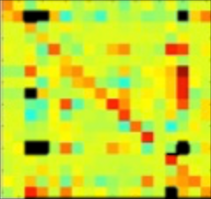
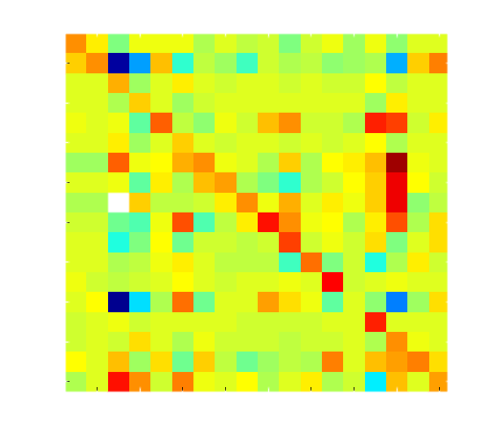
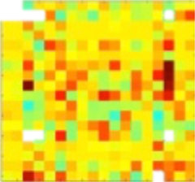
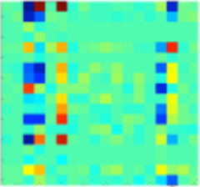

Helping Students Learn to Program
It looks like you have a fencepost error!
// User defined method
def main():
while(isClear()):
put_beeper()
move()
put_beeper()
main
while
putBeeper
cond
body
putBeeper
move

Slide 106
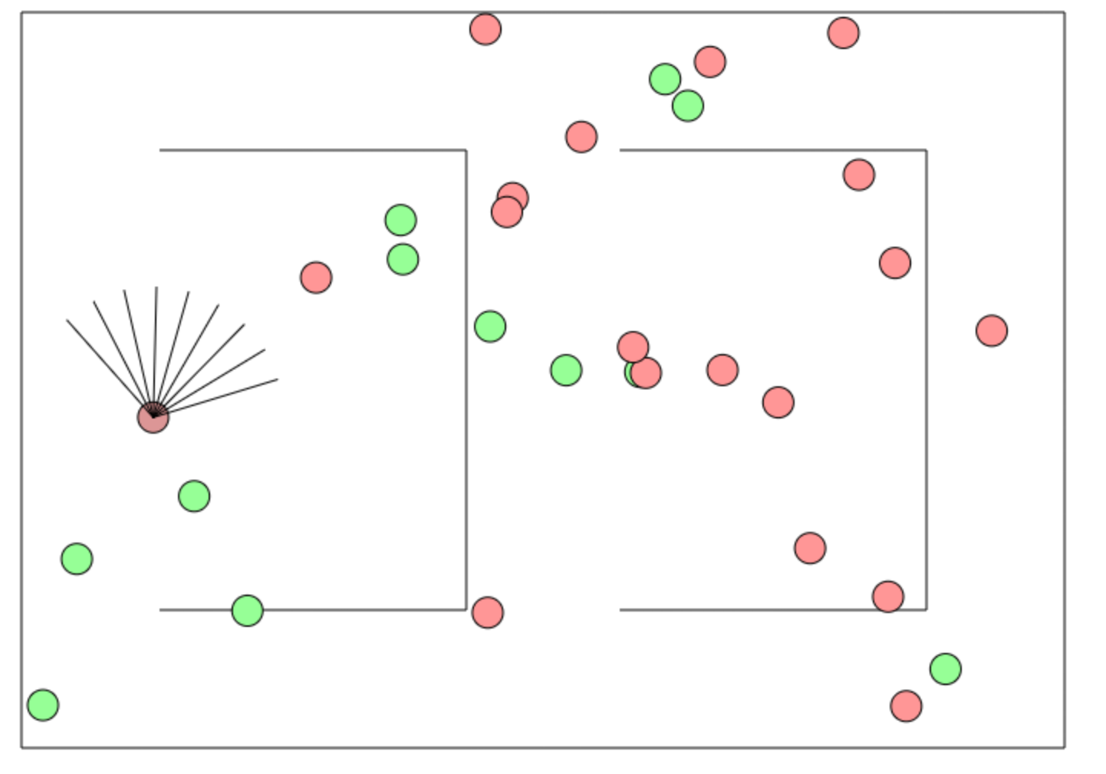
Beyond Harry Potter Hats
http://cs.stanford.edu/people/karpathy/convnetjs/demo/rldemo.html

Slide 107
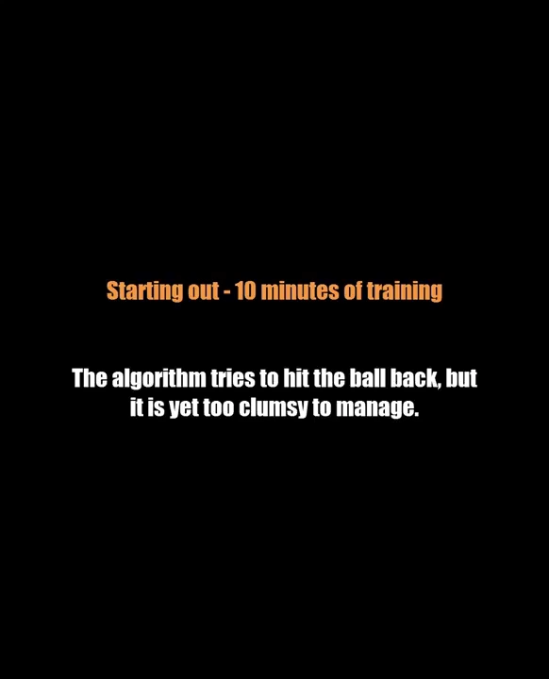
Beyond Classification

Slide 108
The Future of AI
Human Intelligence
Performance
Complex Programs
Neural Networks
Time
Now
2012
Notes:
NVIDIA or ATI will be future of AI. Probably NVIDIA.

Slide 109
The Future of AI
Human Intelligence
Performance
Complex Programs
Neural Networks
Time
Now
2012
Notes:
NVIDIA or ATI will be future of AI. Probably NVIDIA.

Slide 110
The Future of AI
Human Intelligence
Performance
Complex Programs
Neural Networks
Time
Now
2012
Notes:
NVIDIA or ATI will be future of AI. Probably NVIDIA.

Slide 111
The Future of AI
Einstein
Human Intelligence
Performance
Complex Programs
Neural Networks
Time
Now
2012
Notes:
NVIDIA or ATI will be future of AI. Probably NVIDIA.

Slide 112
Open Problems?

Slide 113
Machine Learning Uses a Lot of Data

Slide 114
One Shot Learning
Single training example:
Test set:

Slide 115
One Shot Learning
Single
training
example:

Slide 116
Where is my robot?

Slide 117
… coming soon

Slide 118
Should I study AI?

Slide 119

Powerful technology

Slide 120
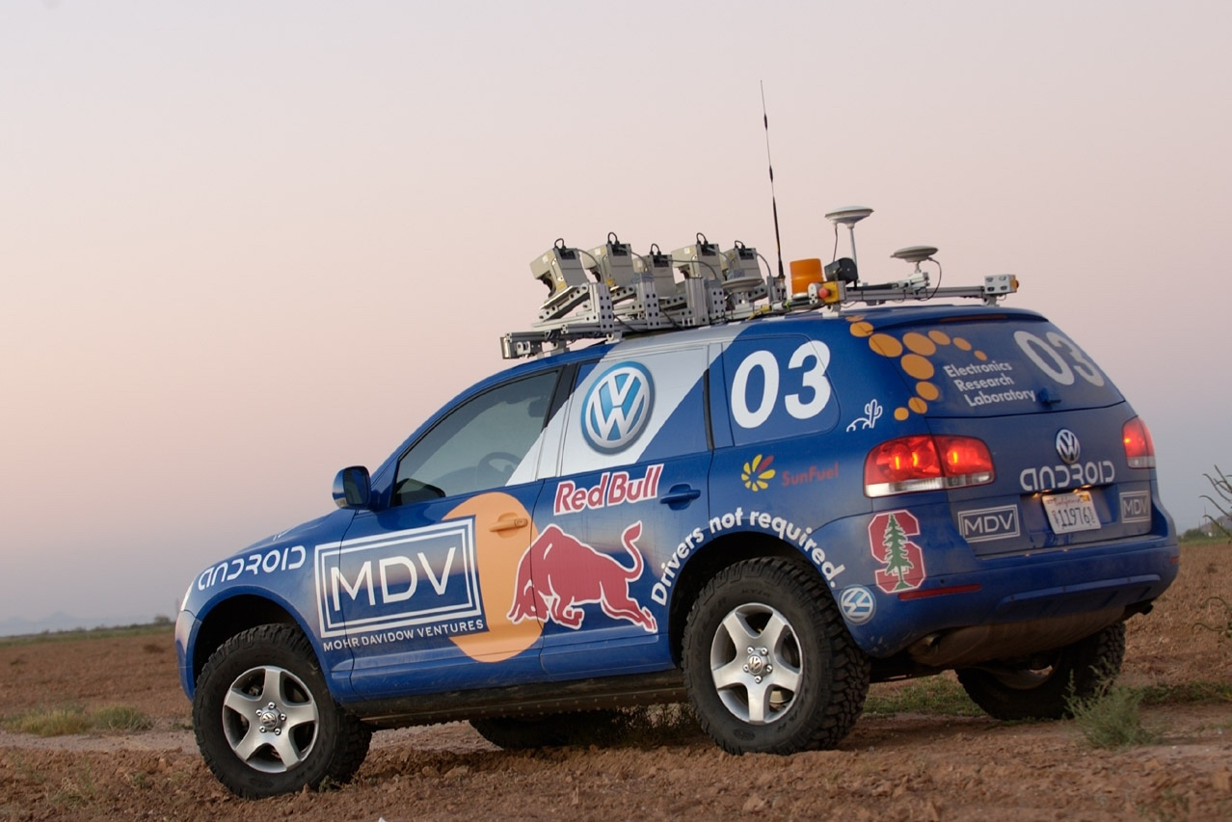
Now is an amazing time

Slide 121
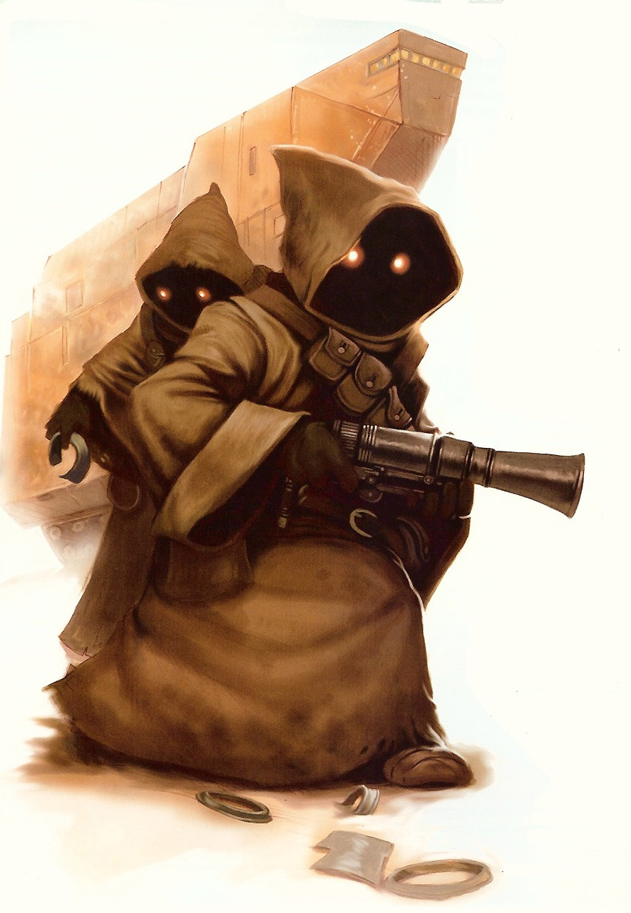
Know It So You Can Beat It
Little math

Slide 122
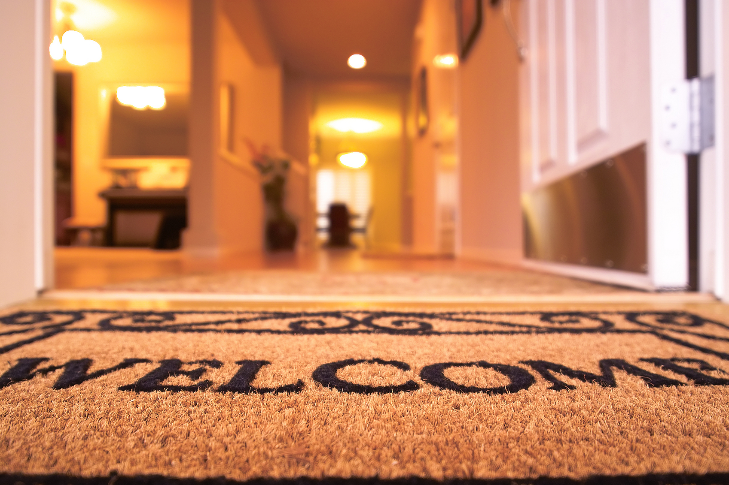
Todos son bienvenidos

Slide 123
Road towards AI
Libraries to use AI
Mathematics to invent AI

Slide 124
Next Step:
…

Slide 126
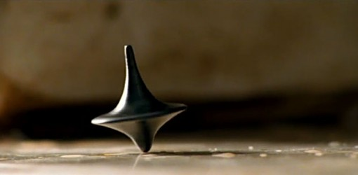
The End?

